Slide 1
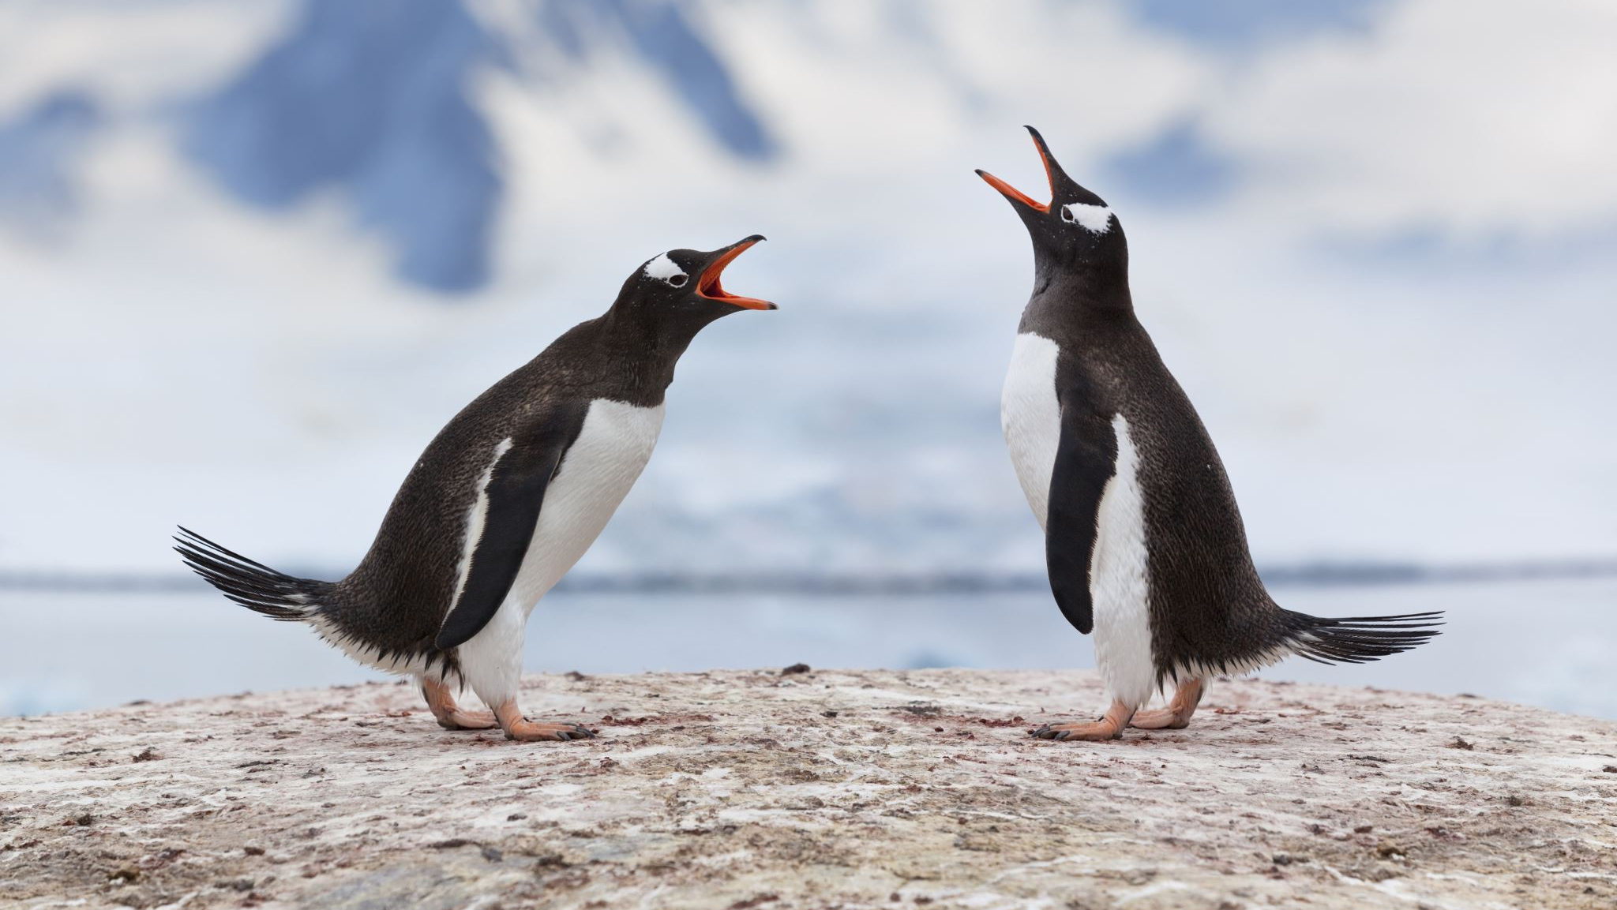
Penguins Species Analysis Using Data Mining Algorithms in R
Justin Vernieri
Data Mining Business Intelligence

Slide 2
Data Exploration

Slide 3

Dataset Overview
Penguins size dataset containing biological measurements of 3 penguin species (Adelie, Chinstrap, Gentoo)
Source: Kaggle
344 observations
7 attributes: Species, Island, Culmen Length (mm), Culmen Depth (mm), Flipper Length (mm), Body Mass (g), Sex
Goal—analyze performance of different data mining algorithms on penguins dataset:
Decision Trees, Random Forest, Naïve Bayes, Neural Network, K-Nearest Neighbor, Support Vector Machine, K-Means Clustering, AdaBoost

Slide 4
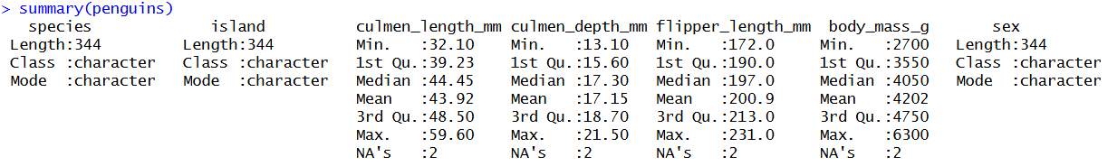
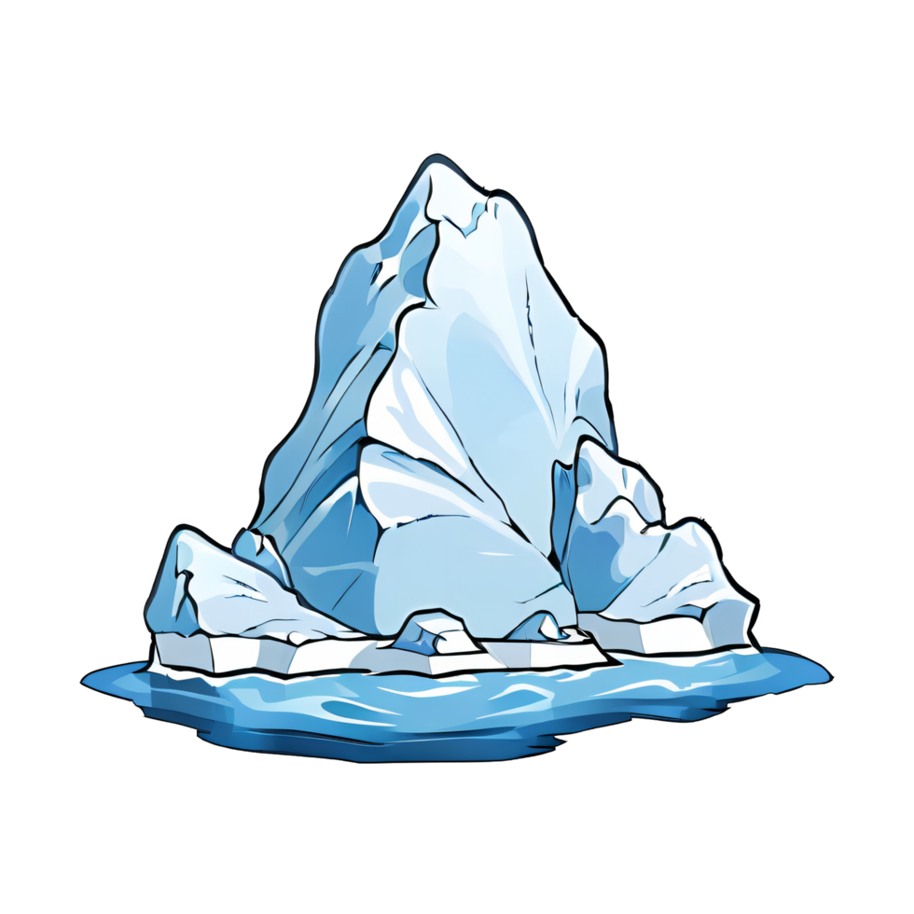


Slide 5
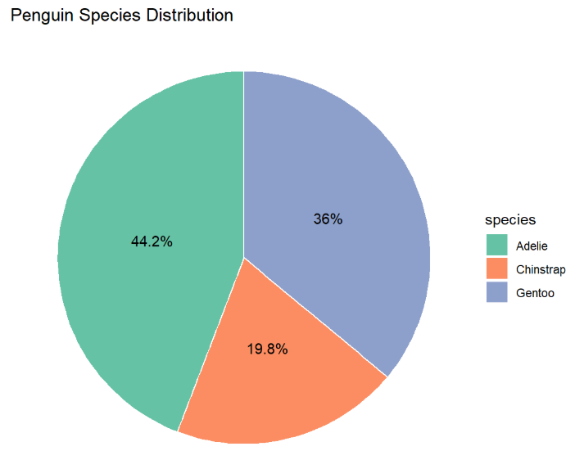
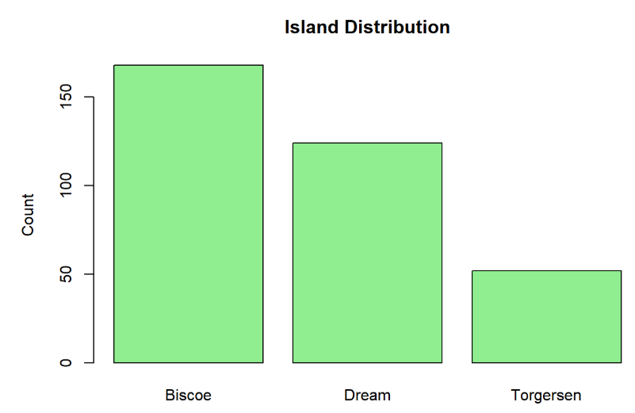
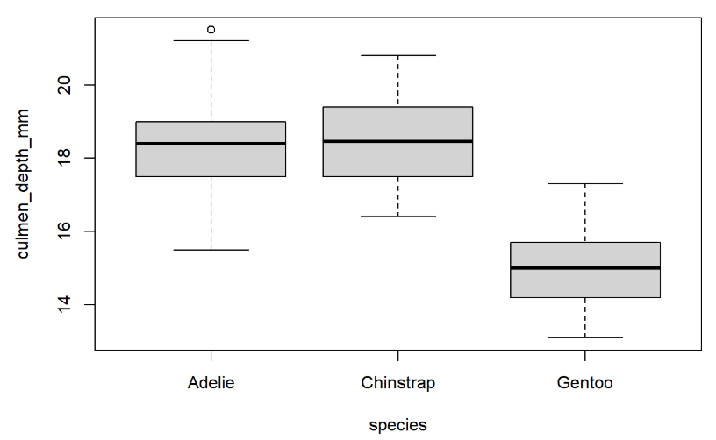
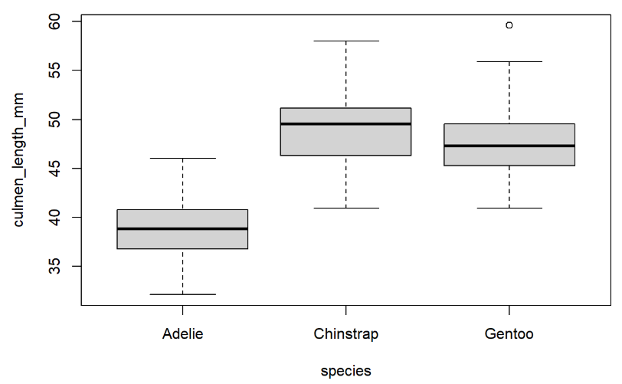
Exploratory Data Analysis
Gentoo species and Biscoe island represented the largest groups in the dataset
Numerical variables show noticeable variation among penguin species
Boxplots identified spread differences and potential outliers (ex. culmen shown to right)
Early exploratory analysis suggested strong predictive potential for algorithms

Slide 6
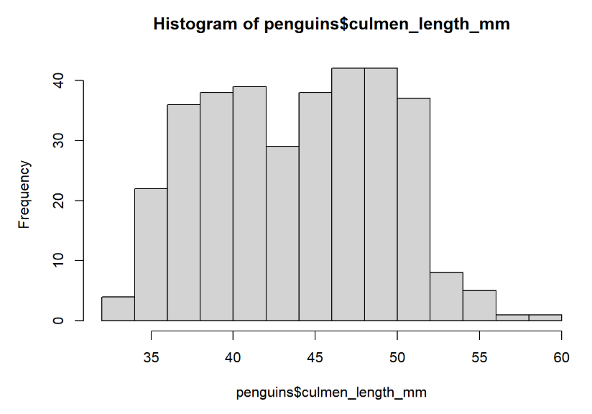
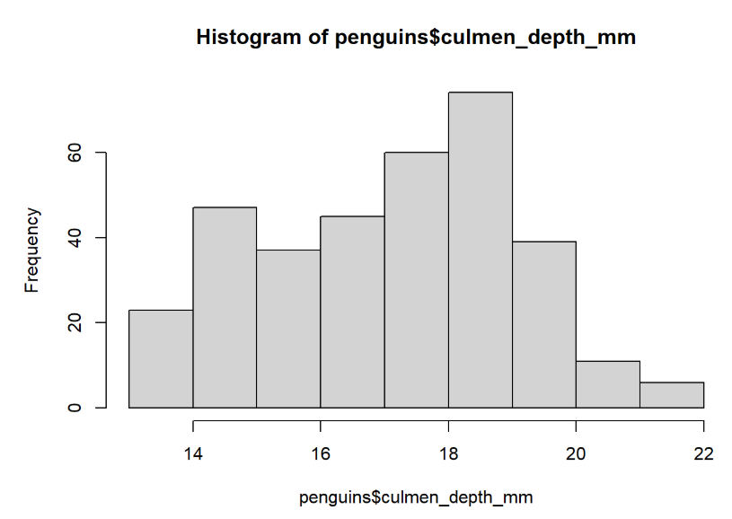
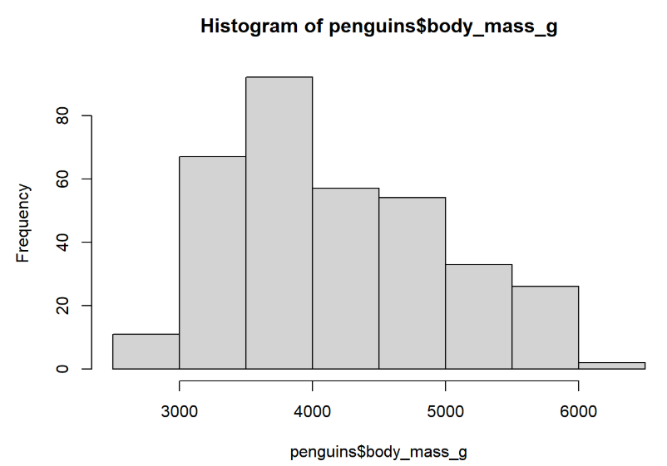
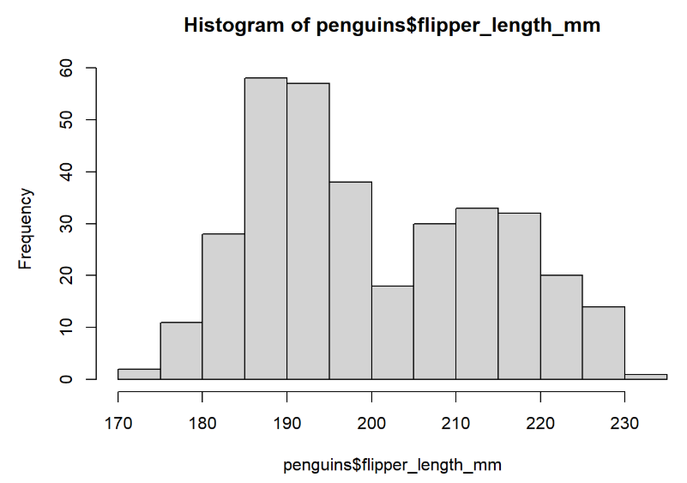

Slide 7
Data Cleaning & Pre-Processing

Slide 8
Missing Values, Data Types, Training/Test Split
Removed observations containing missing values
Converted categorical variables to factors data types for modeling compatibility
Split dataset into 70% training data and 30% testing data

Slide 9
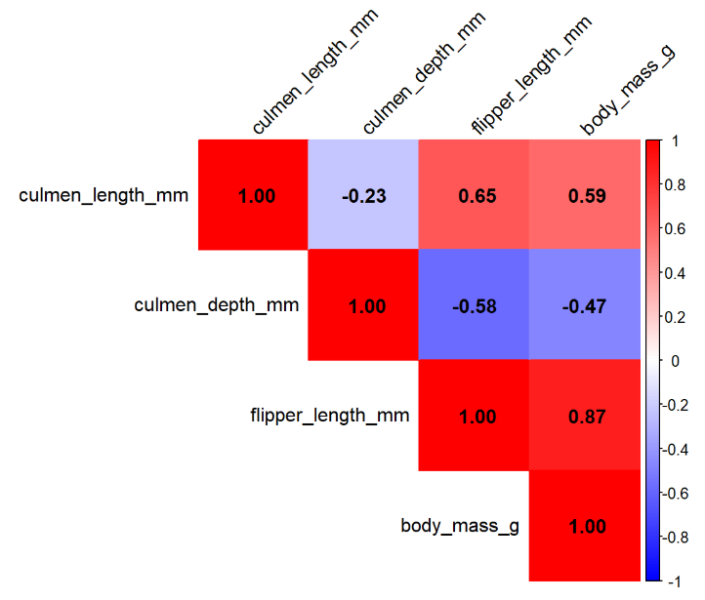
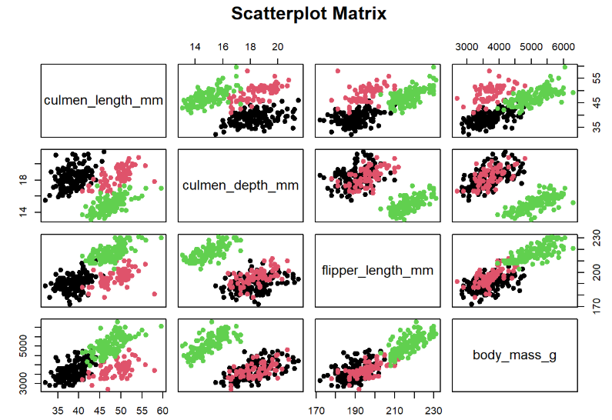
Correlation & Feature Relationships
Numerical variables exhibited moderate-to-strong relationships
Strongest positive correlation: flipper length and body mass (~0.87)
No correlations exceeded the multicollinearity threshold of ±0.9 → all numerical variables were retained for modeling
Scatterplot matrix suggests clustering among species with overlap for certain attributes

Slide 10
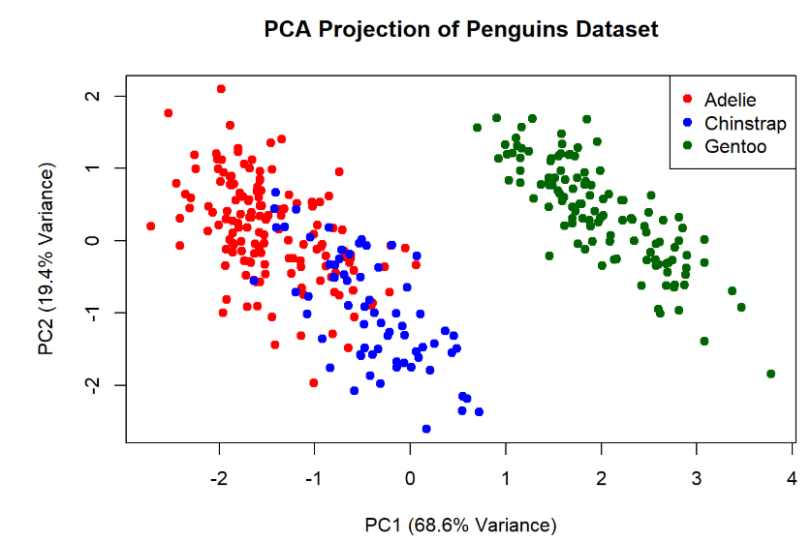
Principal Component Analysis (PCA)
PCA was used to explore dimensionality reduction and overall dataset structure
Dimensionality reduction was ultimately unnecessary since no variables exceeded the correlation removal threshold
First principal component explained ~68.6% of total variance
First two principal components together explained ~88% of dataset variance
PCA projection showed relatively distinct clustering patterns among penguin species

Slide 11
Normalization & Dummy Variable Encoding
Applied min-max normalization to numerical variables for NN, KNN, and SVM so larger-value attributes would not always dominate
Converted categorical variables into binary dummy variables for NN, KNN, SVM
Island → islandBiscoe, islandTorgersen, islandDream = 0 or 1
Sex → sexMale, sexFemale = 0 or 1

Slide 12
Data Mining Algorithms (8)
Decision Tree, Random Forest, Naïve Bayes, Neural Network (NN), K-Nearest Neighbor (KNN), Support Vector Machine (SVM), K-Means Clustering, AdaBoost

Slide 13
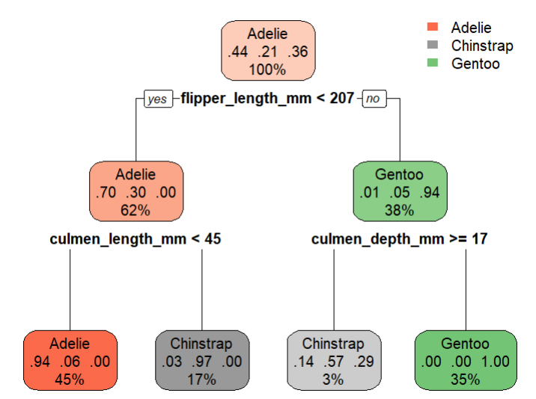
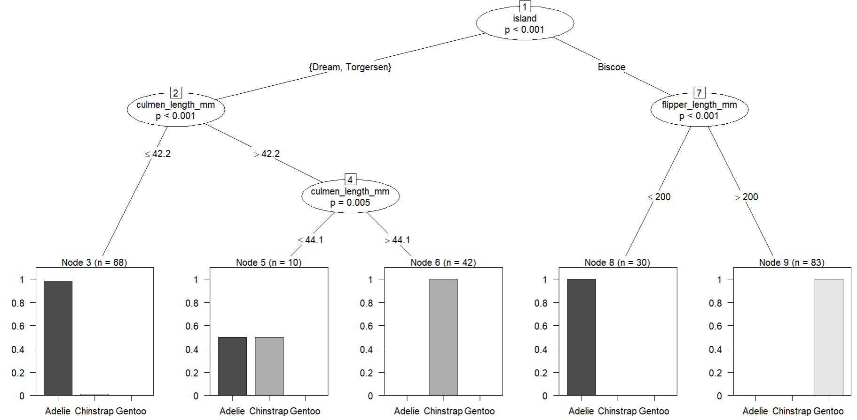
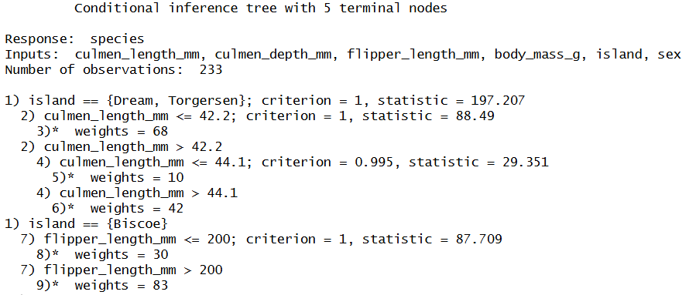
Algorithm 1: Decision Tree
Built interpretable tree-based classification models
Evaluated both ctree and rpart algorithms in R
Island, culmen & flipper measurements were primary decision variables
Pruned rpart tree produced a simpler visualization while maintaining ~95% test accuracy
ctree ~97% test accuracy

Slide 14
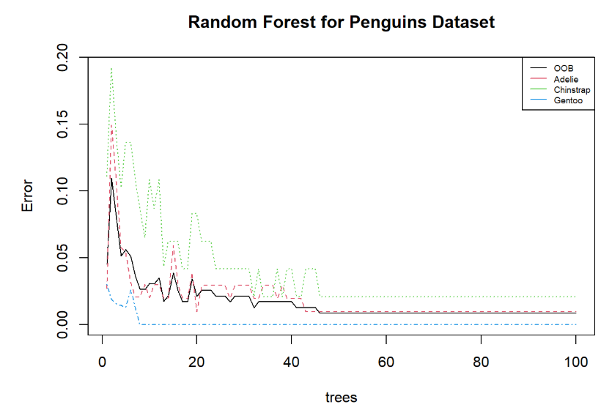
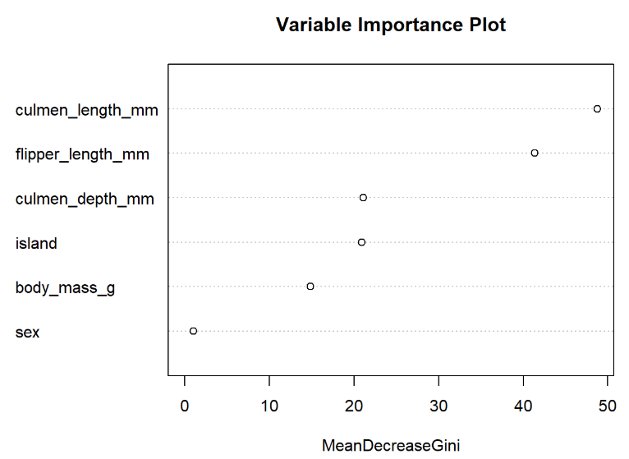
Algorithm 2: Random Forest
Ensemble learning method using multiple trees
Achieved extremely high classification accuracy (~98%)
Out-of-bag (OOB) error rate dropped below 1% after approximately 40 trees
Variable importance analysis identified flipper length and culmen length as highly influential

Slide 15
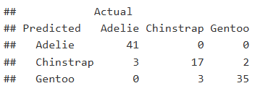
Algorithm 3: Naïve Bayes
Probabilistic classification model
Partial model using only culmen measurements achieved ~92% accuracy
Full model will all predictors achieved near-perfect accuracy

Slide 16
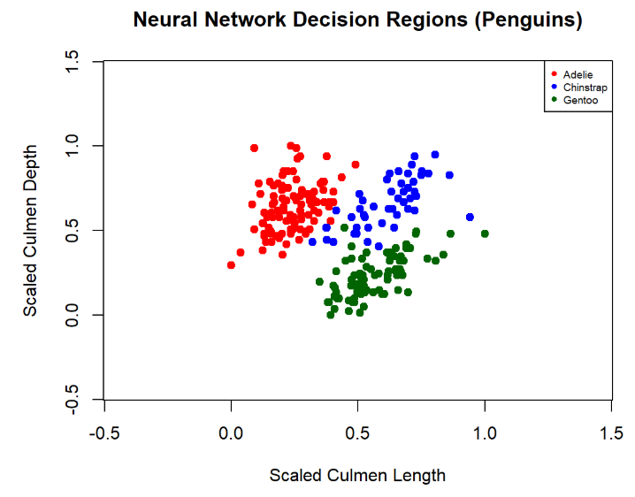
Algorithm 4: Neural Network
Single hidden-layer neural network, used normalized numerical attributes
Partial model focused on culmen measurements for 2d visualization
Decision regions shows nonlinear separation between penguin species
Model | Input Neurons | Hidden Neurons | Output Neurons
Partial Model (culmen length and depth) | 2 | 5 | 3
Full Model (all predictors) | 9 | 5 | 3

Slide 17
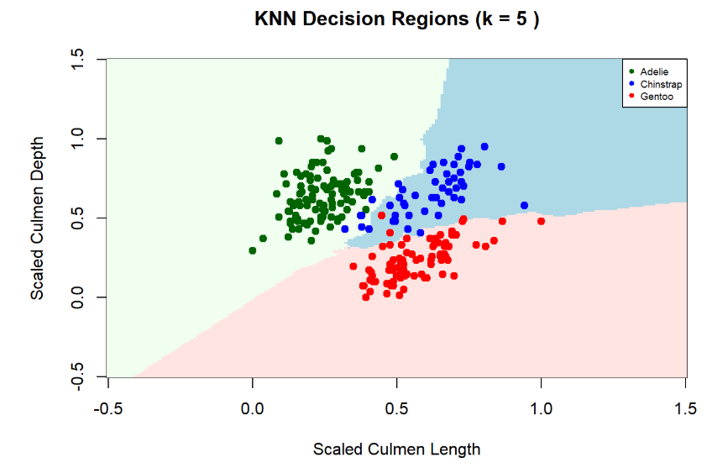
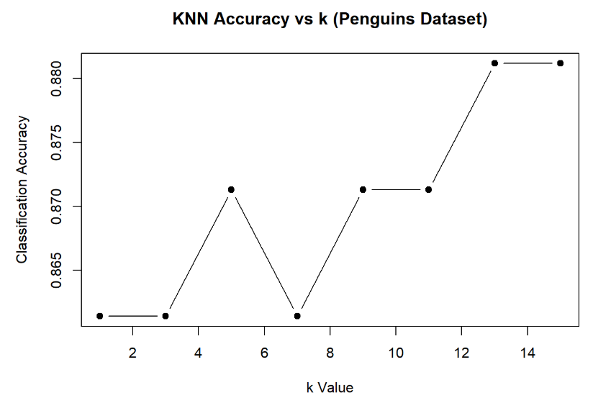
Algorithm 5: K-Nearest Neighbor (KNN)
KNN classified observations using nearest-neighbor similarity
Used normalized numerical attributes to ensure fair distance calculations
Used culmen measurements in partial model for 2d visualization
Performance depended on choice of k (# of neighbors)
Hyperparameter tuning tested multiple k values: 1, 3, 5, 7, 9, 11, 13, and 15
Higher k values (13, 15) performed best

Slide 18
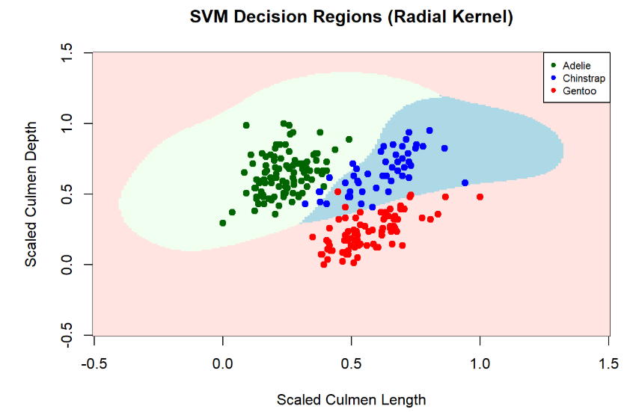
Algorithm 6: Support Vector Machine (SVM)
Used normalized numerical attributes
Used radial kernel for nonlinear separation
Used culmen measurements in partial model for 2d visualization
SVM constructed optimal hyperplanes between species
Full model with all predictors improved accuracy from ~0.87 → ~0.96

Slide 19
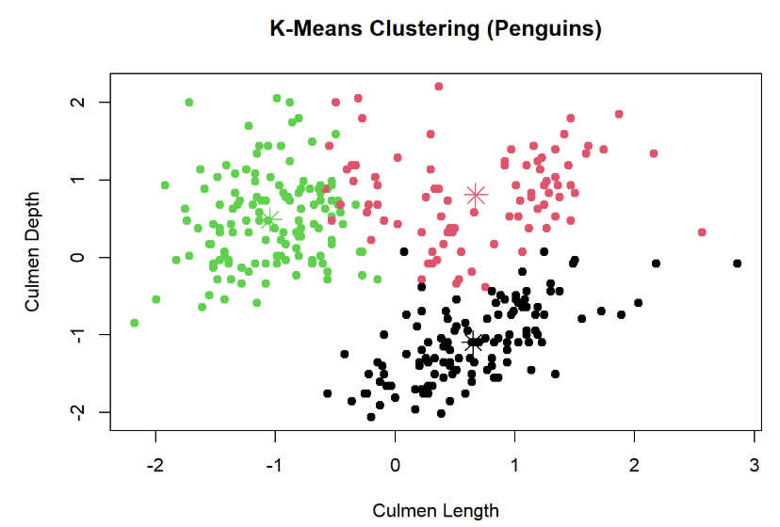
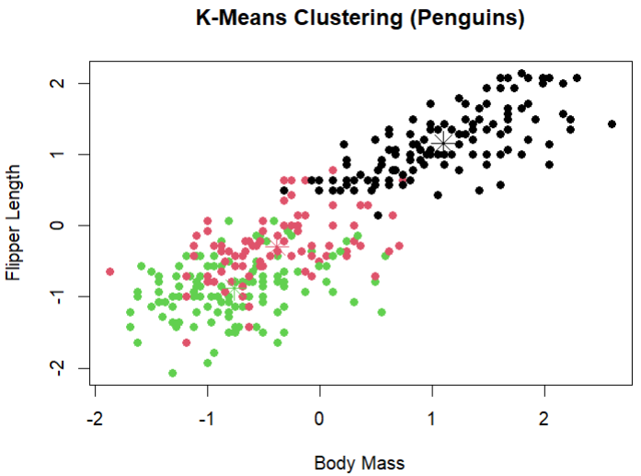
Algorithm 7: K-Means Clustering
Unsupervised learning technique with species labels removed
Numerical variables were scaled prior to clustering to standardize distance calculations
3 clusters were generated to match species count
Cluster centers represented the average feature values with each group
Black points formed most distinct and consistently separated clusters across all attribute combinations
Red and green points showed the greatest overlap
Some observations may be incorrectly assigned to neighboring clusters based solely on proximity to cluster centers

Slide 20
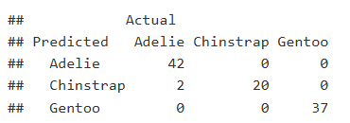
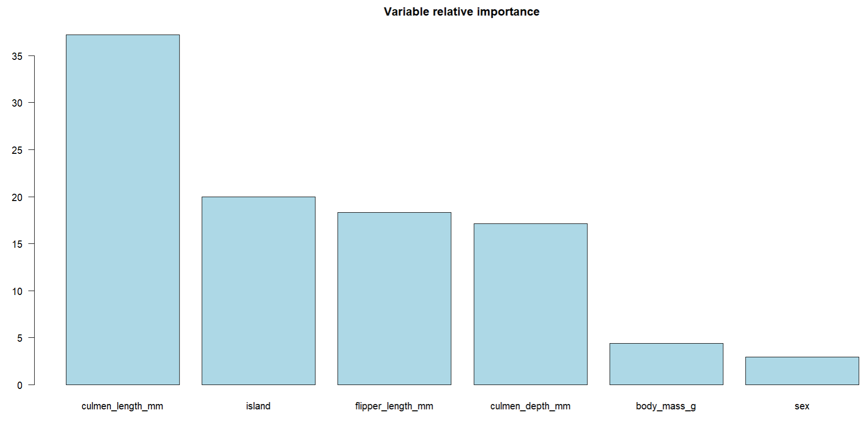
Algorithm 8: AdaBoost
AdaBoost sequentially improved weak learners
Focused on correcting previous classification errors
Ensemble boosting improved classification strength
Achieved ~98% test accuracy

Slide 21
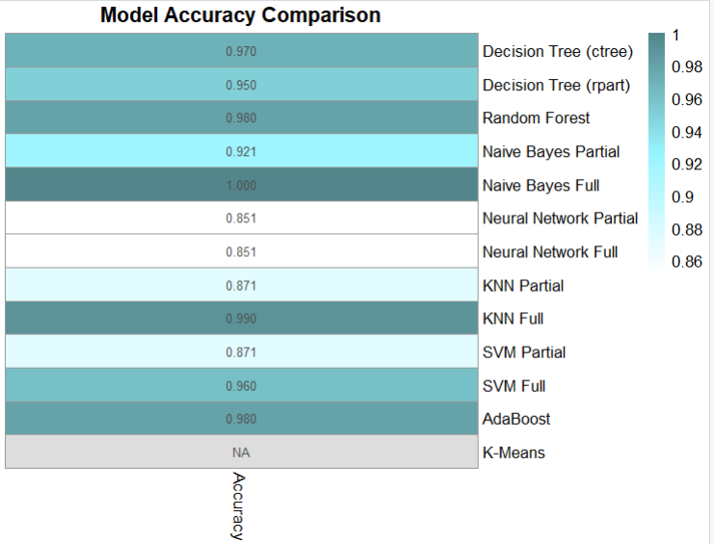
Summary & Algorithm Comparison
Ensemble methods produced strongest overall performance
Random Forest and AdaBoost achieved highest accuracies
Simpler models still performed strong due to clear feature separability
Full models consistently outperformed partial two-variable models

